Slide 1



SMART HOSTEL AND ROOM ALLOCATION SYSTEM
Name - Soujash Chatterjee
Roll no - 48
Enrollment no - 12024052017016
CSE(IOTCSBT)

Slide 2
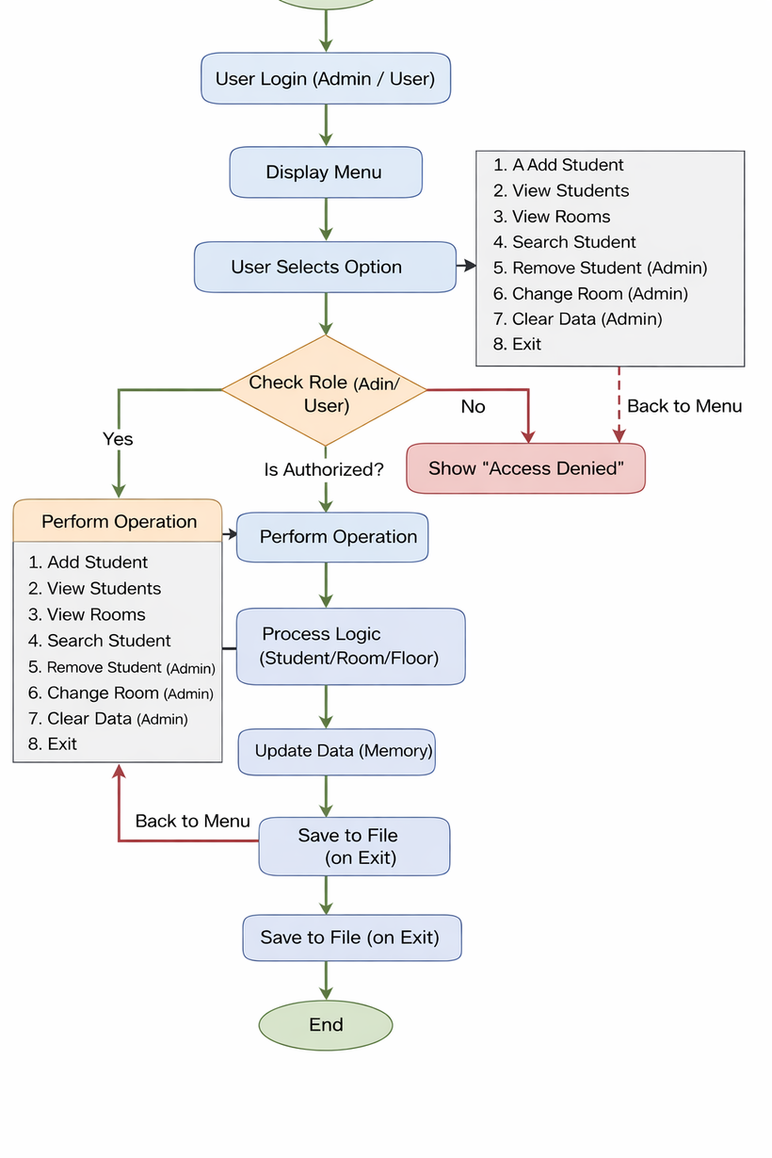

KEY CLASSES & RESPONSIBILITIES
1. Student
Encapsulates student data (ID, name)
Provides controlled access using getters
2. Room
Encapsulates room details (room no, capacity, students list)
Implements core business logic:
•addStudent()
•isFull()
Maintains object relationship
3. HostelManagementSystem
Acts as controller layer
Handles user input and decision-making
Coordinates between Student and Room objects
Maintains collections (List of Students, Rooms)
PACKAGE STRUCTURE
•model (Student, Room, Floor)
•controller (HostelManager, Main)
•utility (FileHandler)
01

Slide 3

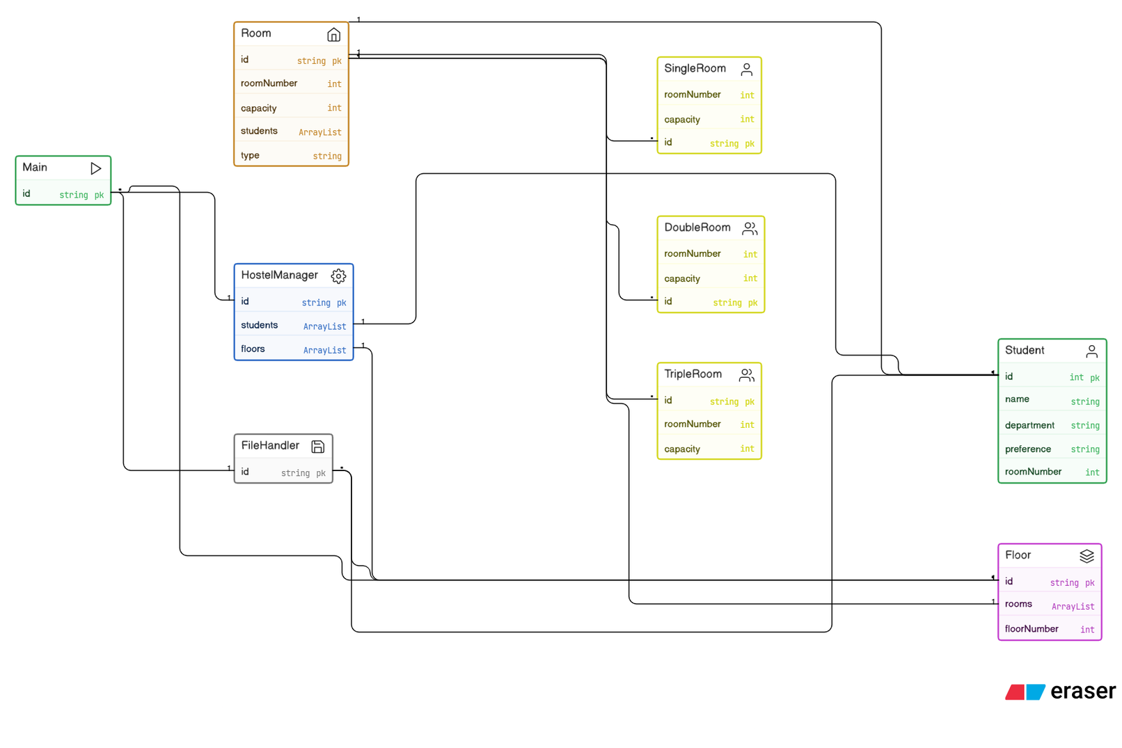
UML DIAGRAM
02

Slide 4
OOPS CONCEPT USED
ENCAPSULATION
Implemented in Student and Room classes
Data members like student id, name, capacity are kept private
Access provided through getter methods
Ensures data security and controlled modification
INHERITANCE
Room is the base class extended by: Single Room
Double Room
Triple Room
Allows reuse of common attributes like room number and capacity
Improves code reusability and scalability
ABSTRACTION
Applied in room allocation process
Complex logic hidden inside methods: Add Student() , is Full()
User interacts only with functionality, not internal implementation
Simplifies usage and reduces complexity
POLYMORPHISM
Enables flexibility in handling various room objects
Supports future enhancements without changing existing code
Same method behaves differently for different room types
03

Slide 5
TECHNICAL HIGHLIGHT
SMART ROOM ALLOCATION LOGIC & ROLE-BASED CONTROL FLOW :
Implements preference-based room allocation with fallback mechanism
Ensures capacity management using dynamic room occupancy tracking
Uses role-based access control with secure admin authentication
Integrates file handling for persistent data storage across sessions
Maintains modular structure using HostelManager for centralized logic
SMART ALLOCATION FLOW:
Check Preference → Find Matching Room → Check Capacity
→ Allocate Preferred Room
Else → Assign Random Available Room
ACCESS CONTROL FLOW:
Login → Verify Credentials → Assign Role
→ Allow / Restrict Operations
04

Slide 6
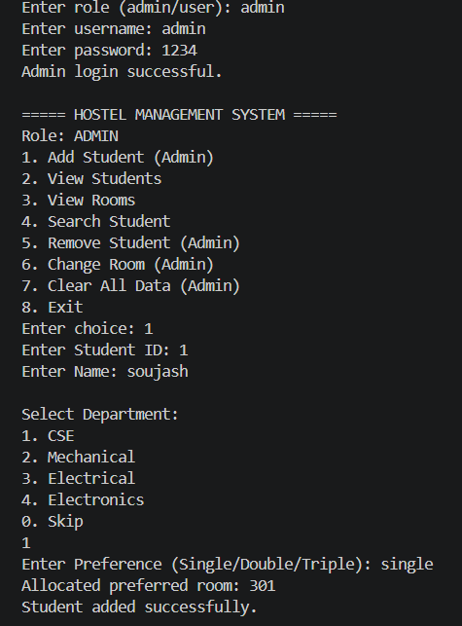

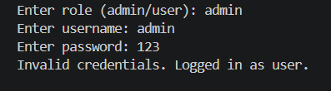


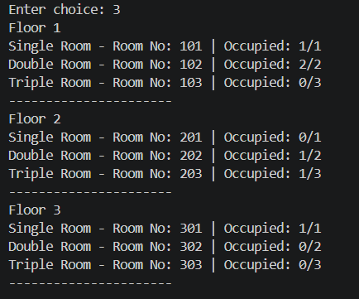
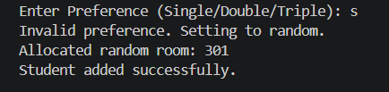
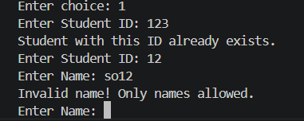

LIVE DEMO
05

Slide 7
THANK YOU
06

